Slide 1
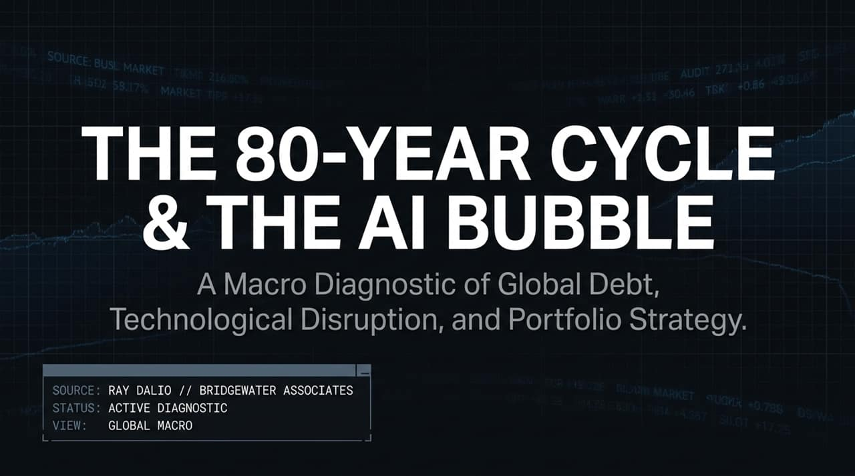
Notes:
https://www.youtube.com/watch?v=Bu0xNDLNORU
Welcome everyone. Today we present a global macro diagnostic based on the analytical framework developed by Ray Dalio, founder of Bridgewater Associates.
Throughout history, major financial crises and systemic shifts do not happen randomly; they follow clear mechanics.
Today, we examine how global debt cycles, technological disruption (specifically AI), and geopolitical shifts collide to shape asset markets and portfolio survival.

Slide 2
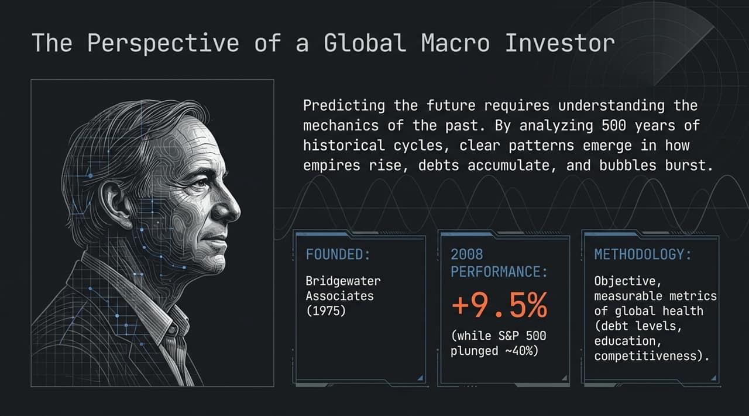
Notes:
To understand where we are going, we must study the mechanics of the past 500 years of economic cycles.
Ray Dalio founded Bridgewater Associates in 1975 and built it into the world's largest hedge fund.
Track Record in Crises: In 2008, when the S&P 500 crashed by nearly 40%, Bridgewater generated a +9.5% return because they identified the debt mechanics leading up to the crash.
Methodology: Macro diagnostics rely on objective, quantifiable data—such as debt levels, productivity metrics, wealth inequality, and reserve currency status—rather than emotion or consensus narrative.

Slide 3
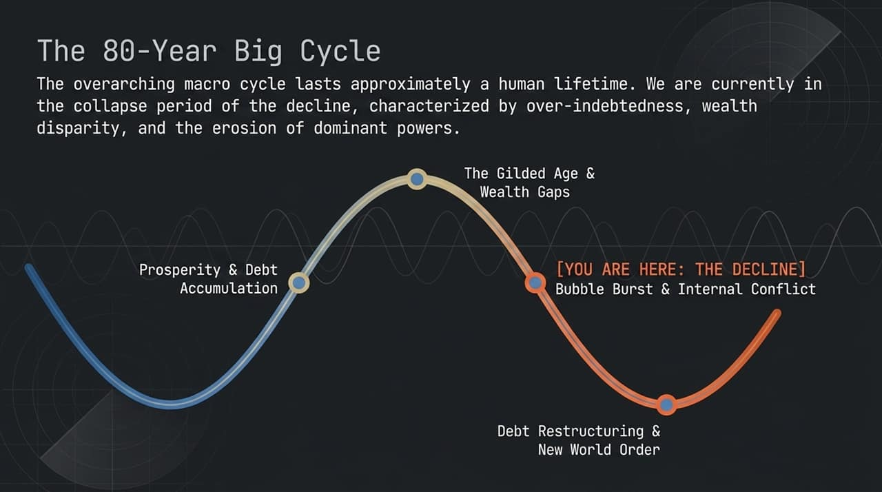
Notes:
The "Big Cycle" lasts roughly a human lifetime (~80 years) and governs monetary, political, and geopolitical systems.
Phases of the Big Cycle:
New Order & Debt Restructuring: Following a major crisis, debts are wiped clean, creating a new monetary order.
Prosperity & Debt Accumulation: Growth expands, leverage builds up, and wealth increases.
The Gilded Age & Wealth Gaps: A period of massive speculative wealth, where asset owners prosper while workers lag behind.
Decline & Collapse [YOU ARE HERE]: Characterized by extreme over-indebtedness, rising inflation pressures, political polarization, and declining hegemony.
Current Diagnosis: We are currently in the late-stage decline phase, characterized by heavy sovereign debt burdens and severe wealth disparities.

Slide 4
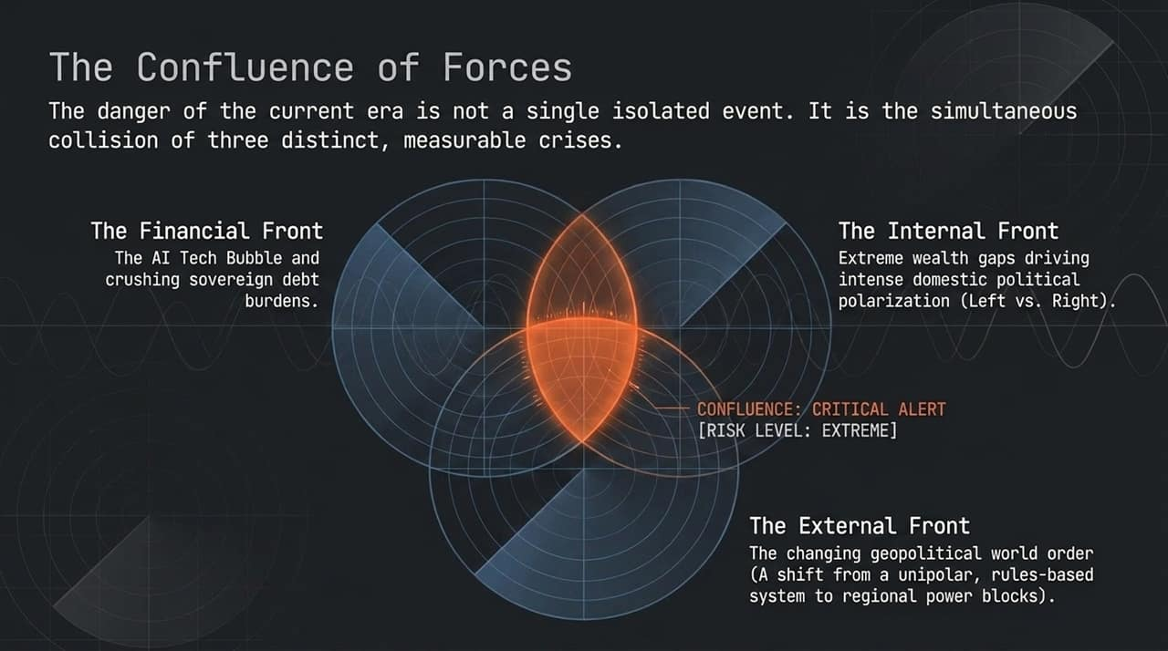
Notes:
What makes this moment exceptionally dangerous is not just one problem, but the simultaneous collision of three major fronts:
Financial Front: Massive sovereign debt service burdens combined with an inflated speculative bubble in AI.
Internal Front: Widening wealth gaps driving extreme domestic political division between the Left and Right, creating gridlock and fiscal instability.
External Front: A fundamental shift in the geopolitical order as unipolar US hegemony gives way to regional power blocks.
Risk Level: EXTREME. When financial bubbles, internal civil friction, and external superpower rivalries align, systemic shifts occur.

Slide 5
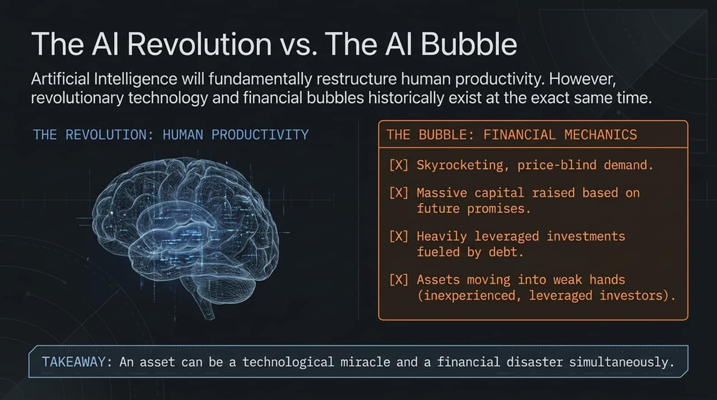
Notes:
The Dual Nature of Tech Shifts: An asset or technology can be a miraculous productivity breakthrough and a catastrophic financial bubble at the exact same time.
The AI Revolution: AI will fundamentally alter human productivity by automating cognitive reasoning and mind-based labor.
The AI Bubble Mechanics:
Skyrocketing demand where investors buy shares without regard to price or earnings.
Companies raising vast capital based on future promises rather than cash flow.
Heavy leverage and debt-fueled speculation.
Assets shifting into "weak hands"—unexperienced, heavily leveraged retail investors buying complex financial products or leveraged ETFs.

Slide 6
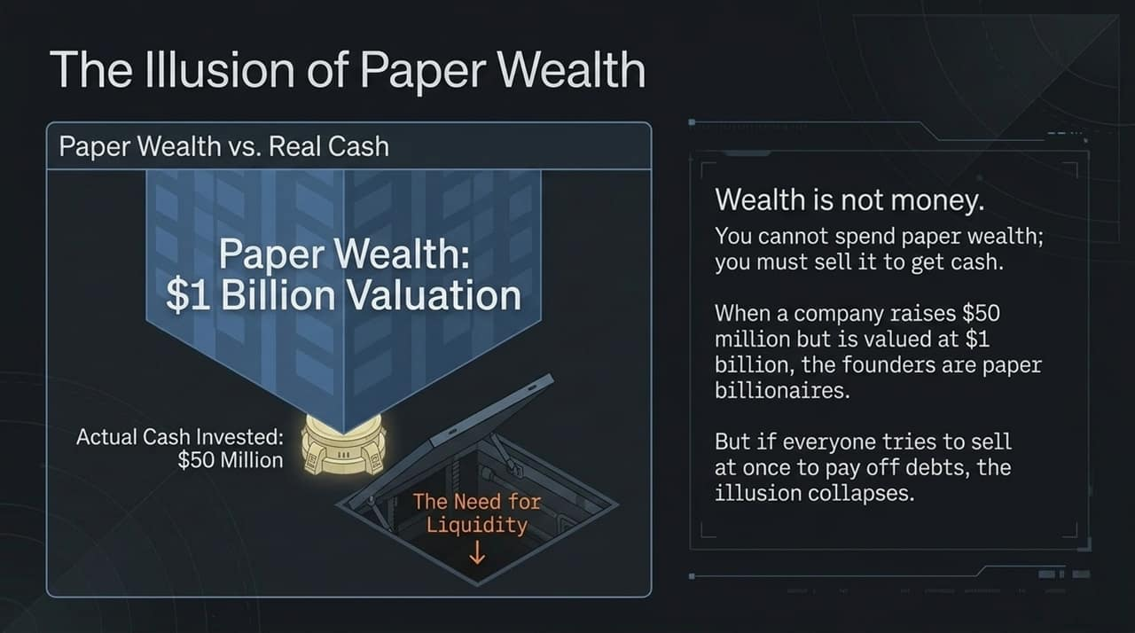
Notes:
Let's trace the mechanical chain reaction when a tech bubble pops:
The Trigger: Inflation forces central banks to raise interest rates and tighten monetary policy.
The Squeeze: Investors with heavy leverage suddenly face steep interest costs to service their debt.
Forced Selling: To meet debt obligations or margin calls, investors must convert paper wealth into real cash, triggering a rush to sell AI stocks.
Collateral Collapse: As asset values drop (e.g., from $100 to $25), net worth vanishes, wiping out borrowing capacity.
Economic Contagion: People cut spending in the real economy, driving down corporate revenues, which causes layoffs and economic downturn.

Slide 7
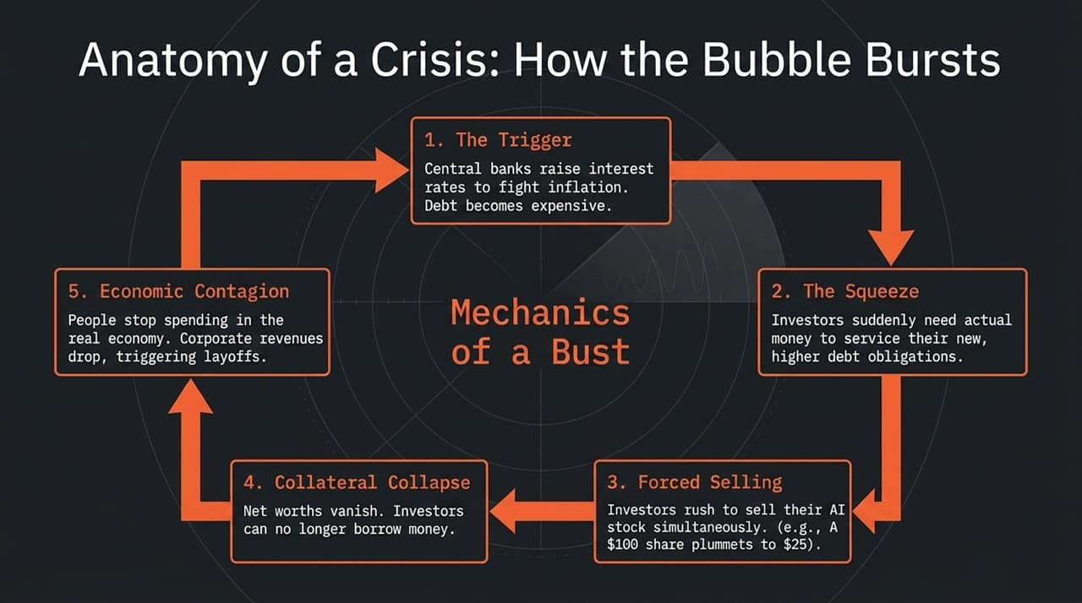
Notes:
The UK serves as a real-time case study of late-stage cycle dynamics.
Symptom 1 (Political Volatility): Having six Prime Ministers in seven years reflects political instability caused by an inability to deliver on economic promises.
Symptom 2 (Unfunded Deficits): Heavily indebted governments running deficits without clear funding sources.
Symptom 3 (Capital Flight): Debates over wealth taxes prompt high earners and capital to leave the jurisdiction.
The Trap: UK leadership faces a structural trap—raising taxes triggers capital flight, while cutting social benefits devastates the population. The result is eventual currency devaluation or debt restructuring.

Slide 8
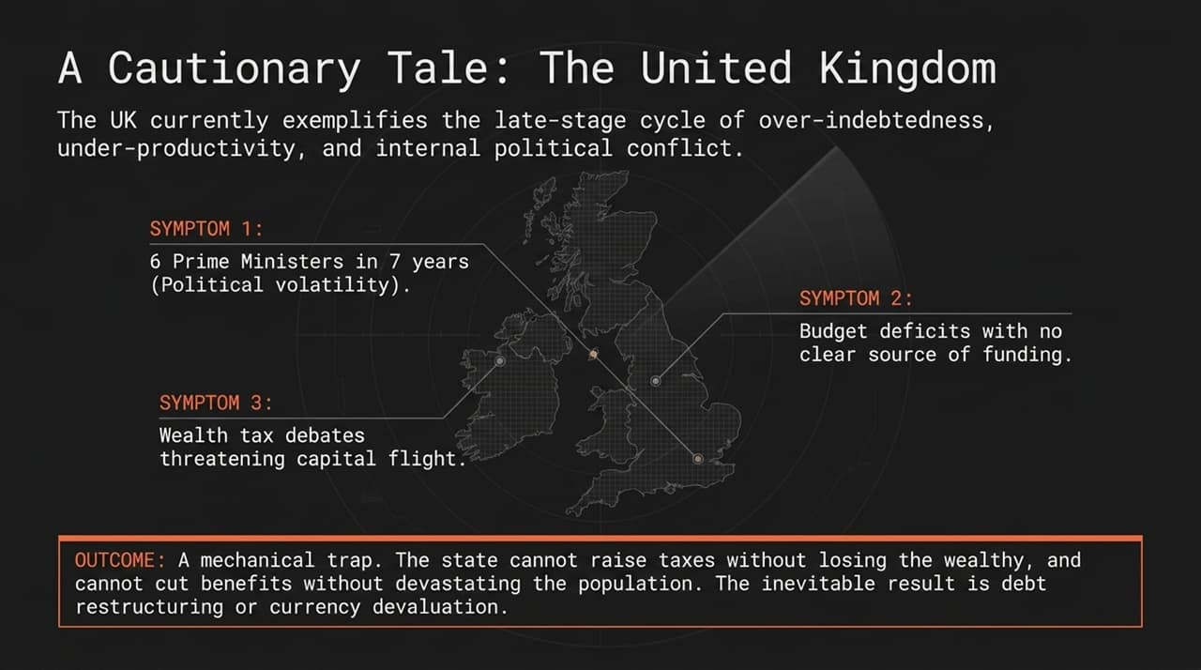
Notes:
The post-WWII rules-based unipolar world order, backed by absolute US economic and military dominance, is fracturing into regional spheres.
China has emerged as a larger trading partner for most nations than the United States.
Non-Military Chokepoints: Modern global power is exerted through economic leverage rather than direct warfare.
Example (Taiwan Semiconductor Chokepoint): A simple 5-day blockade of semiconductor exports from Taiwan would crash global stock markets overnight without firing a shot, demonstrating the limits of traditional military deterrence.

Slide 9
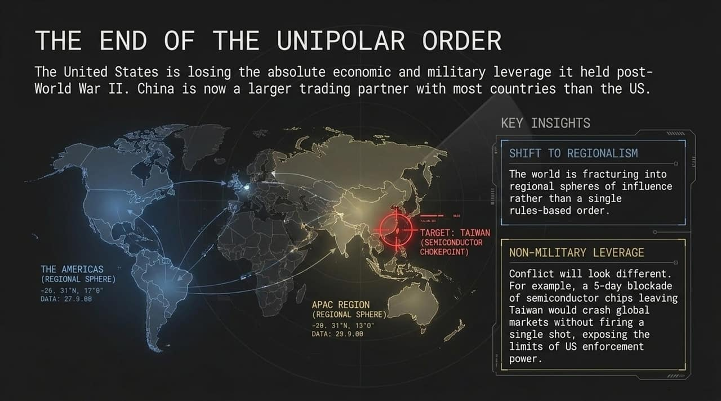
Notes:
Let's evaluate asset classes through Dalio's macro diagnostic matrix:
Cash: Worst long-term holding. Inflation eats away purchasing power at ~3.5–4% annually, compounded by taxes on interest gains.
Stocks: Crucial for capturing human productivity gains, but subject to severe bear markets (60–70% drawdowns during bubble bursts).
Government Bonds: High risk in inflationary environments due to yield locking.
Gold: Recommended 5–15% allocation. Non-printable, hard money immune to counterparty or sanction risk.
Bitcoin: Digital hard money that cannot be printed, but carries volatility, regulatory tracking, and technological risks.

Slide 10
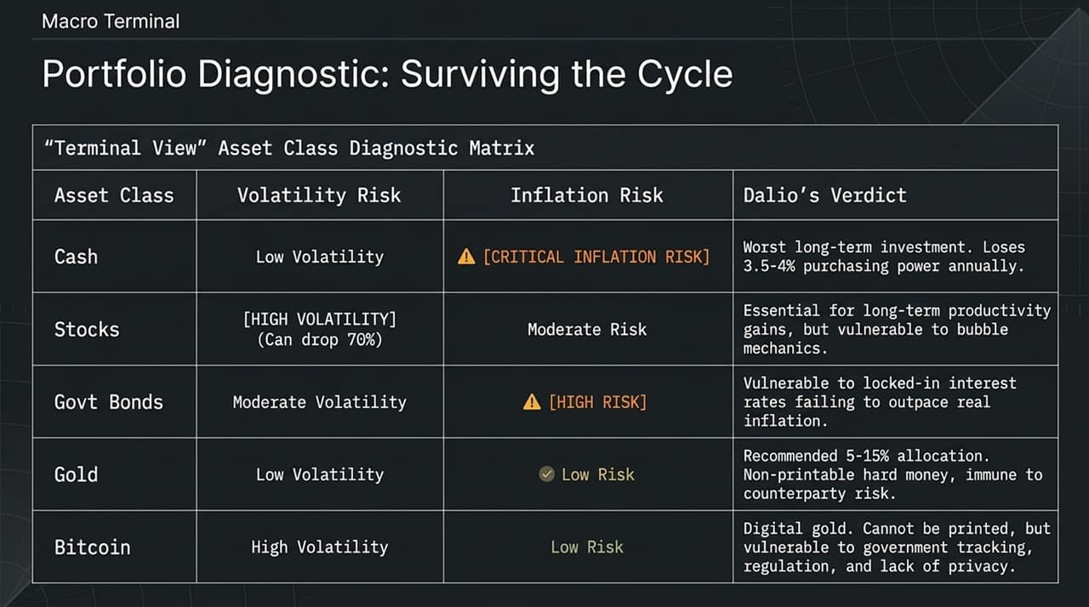
Notes:
We are stepping into a historical paradigm shift in labor substitution:
Agricultural Era: The tractor replaced pure physical muscle power.
Industrial Era: Factories and automation replaced assembly-line manual labor.
AI Revolution: AI is automating cognitive functions—logical reasoning, analysis, coding, and information processing.
Unlike previous technological revolutions, AI directly targets white-collar, intellectual labor.

Slide 11
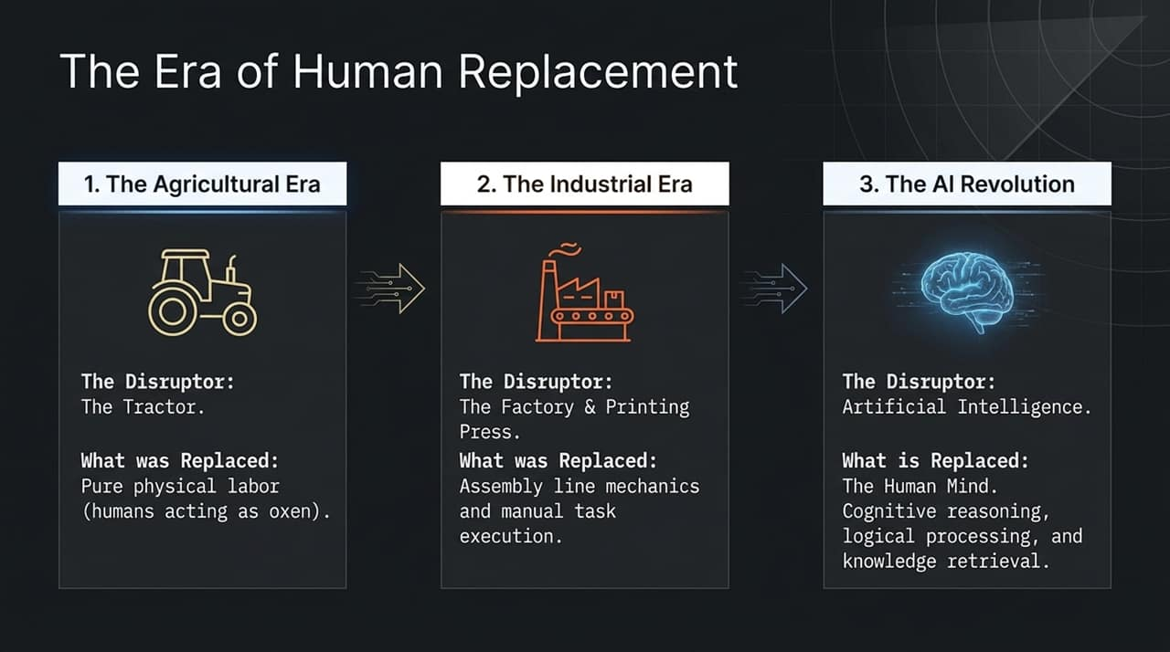
Notes:
What AI Replaces: Standard coding, repetitive analysis, and routine intellectual tasks.
The Core Human Edge:
Emotional Empathy & Intuition: Relationship building, deep empathy, and nuanced human connection.
Adaptability: The ability to pivot quickly in rapidly shifting environments.
AI Partnership: Operating as strategic directors who leverage AI tools to multiply output rather than competing against them.
Takeaway: History rewards those who adapt to change, not simply those who possess raw intelligence.

Slide 12
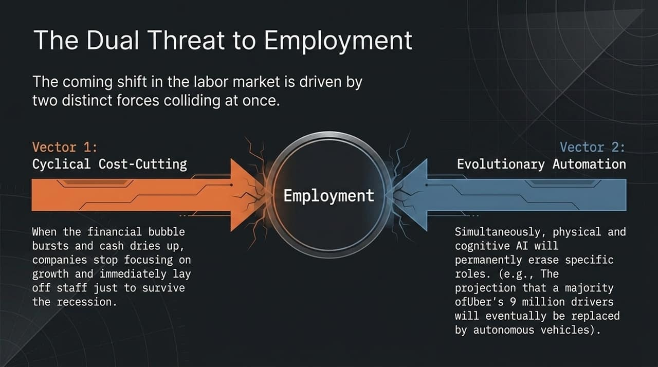
Notes:
Macro Framework: The 80-year cycle connects high debt levels, severe wealth inequality, and changing geopolitical orders.
Cash Trap: Holding cash guarantees a steady loss of purchasing power to inflation.
Hard Assets: Allocate 5% to 15% of a diversified portfolio to gold and non-printable hard money to shield against monetary instability.
Bubble Dynamics: Speculation and debt push stock valuations into weak hands before higher interest rates trigger liquidations.
Human Capital: The ultimate investment is adaptable human capital—mastering AI tools to remain in the top tier of talent.

Slide 13
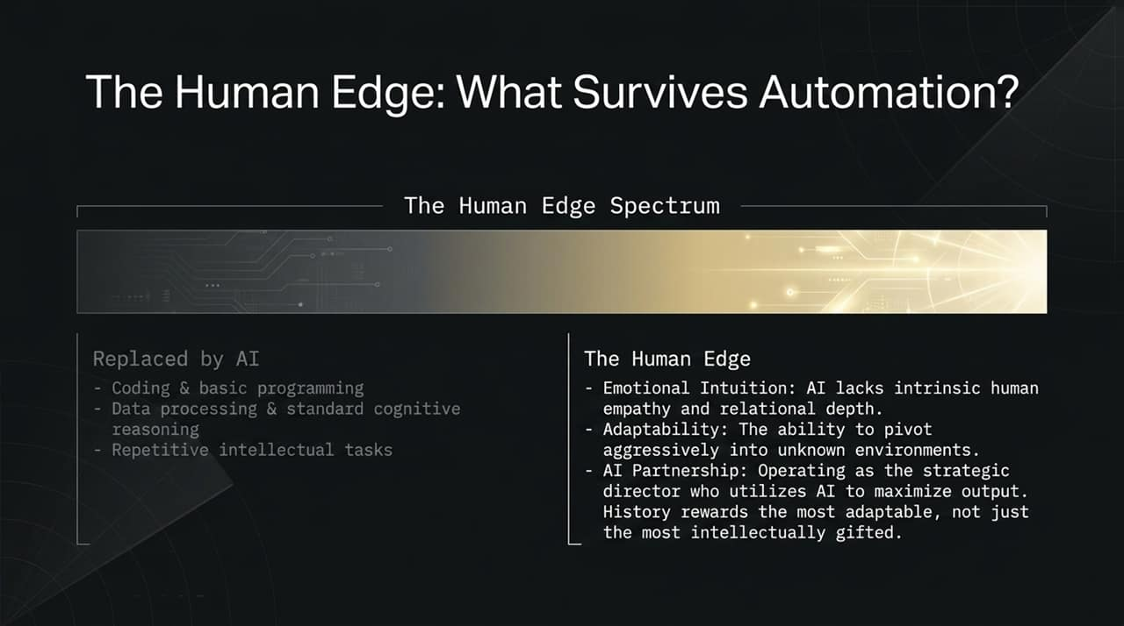
Notes:
While over 60% of US adults have indirect exposure to stocks through retirement funds, ownership is deeply concentrated.
Concentration Ratio: The top 10% of households hold roughly 90% of all US stock wealth.
Impact: During market booms, asset inflation overwhelmingly expands wealth for top capital owners while leaving the bottom 90% behind, widening societal inequality.

Slide 14
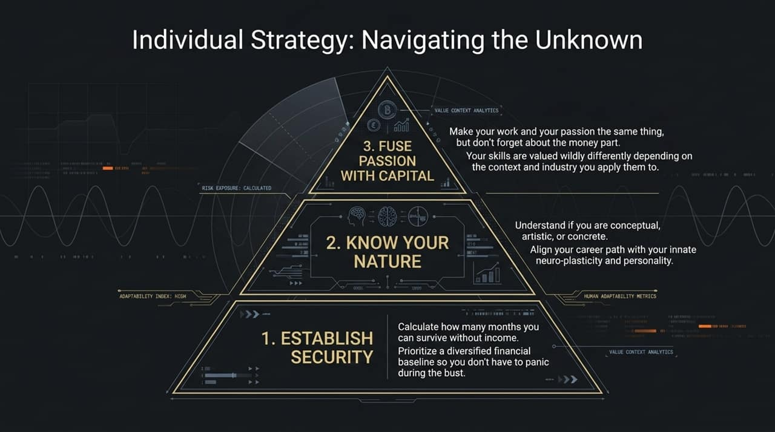
Notes:
When long-term debt cycles reach their peak and bubbles burst, standard asset drawdowns are significant.
Historical bear markets following major speculative bubbles (such as 1929 or 2000) see equities plunge 60% to 70% from peak valuations.
Risk management and portfolio diversification are essential to protect capital during these cyclical busts.

Slide 15
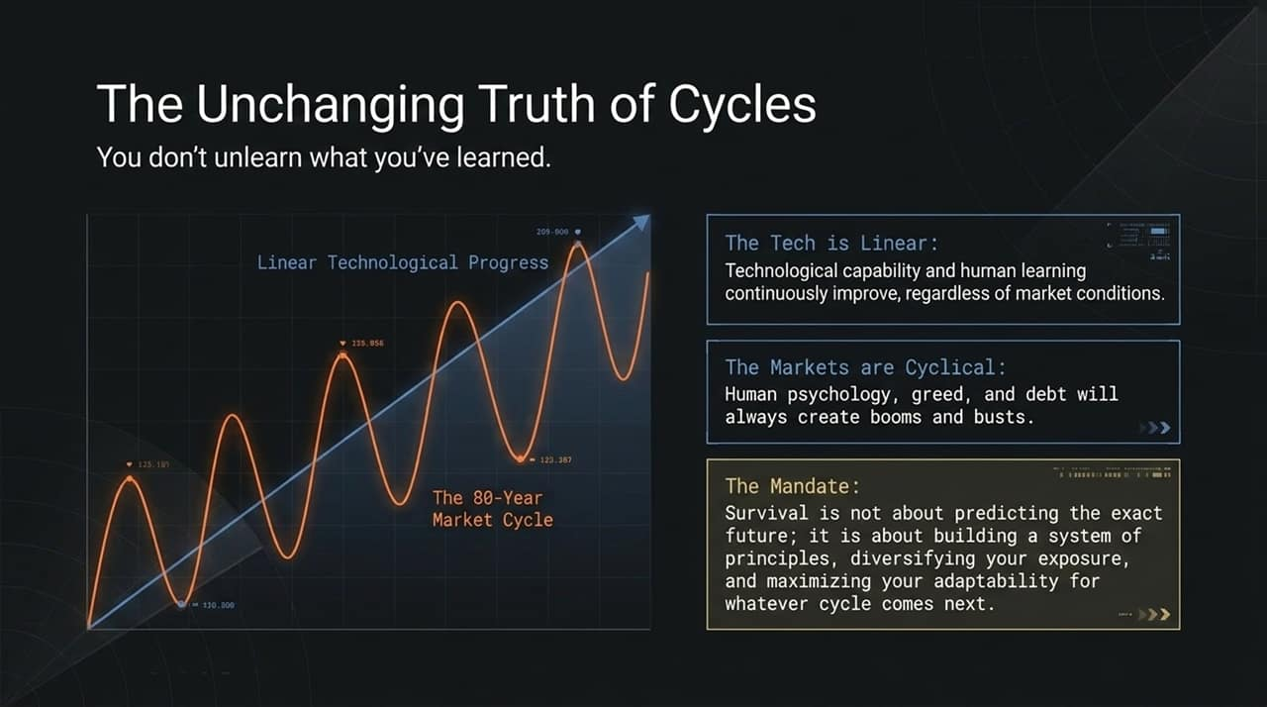
Notes:
How should individuals prepare for economic turbulence?
Focus on Personal Productivity: Your primary asset is your adaptability and skill set.
Build Strategic Reserves: Measure how many months or years you can sustain your family without incoming income.
Asset Allocation: Balance volatile equities with real assets, housing, and hard money (e.g., gold) to protect purchasing power.
Master AI Capabilities: Leverage AI to increase output efficiency rather than competing against automated systems.

Slide 16
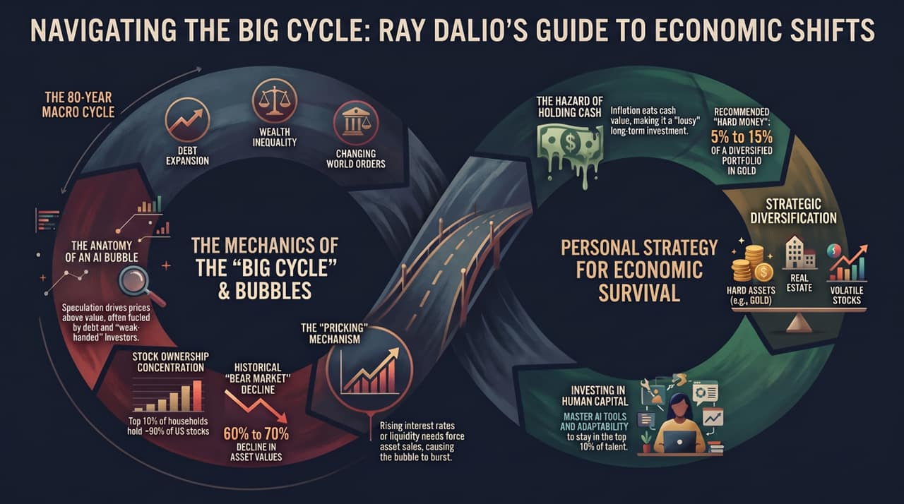
Notes:
Summary:
The global economy is operating under the late stage of an 80-year Big Cycle.
AI represents a structural shift in human productivity, but current financial speculation carries classic bubble mechanics.
Geopolitics and sovereign debt strains favor hard assets, disciplined diversification, and continuous personal adaptability.
Thank you for your time. Let's open the floor to questions and discussion.

